Slide 1
Analysis of College Donations using Tableau
Case 3: College Donations
SCH-MGMT 602
Urvi Ravindra Dhomne

Slide 2
Introduction
This presentation analyzes donor contributions to colleges and academic programs, focusing on key trends and distributions. It covers:
Geographic Distribution: Regions contributing the most donations.
College Types & Academic Majors: Top recipients and key disciplines.
Graduation Years: Alumni giving patterns.
Top Donors: Majors and colleges receiving the highest support.
Trends Over Time: Changes in donation patterns.
The insights aim to guide the advisory board in understanding donor behavior and enhancing future fundraising strategies.

Slide 3
1.The distribution of donations by geographic locations
Highest Contributions: Illinois (445,920) and California (222,960) stand out as the states with the highest donation totals.
Moderate Contributions: States like Florida, Colorado, and New York have donations of 22,296, reflecting significant but not top-tier amounts.
Lowest Contributions: Many states, such as Montana and North Dakota, show no donations or minimal contributions (e.g., 11,148).
Regional Impact: Donations seem heavily concentrated in urbanized or populous states, indicating possible correlations between population density, economic activity, and donation levels.
Strategic Focus: Efforts to increase donations could target underperforming regions like the northern Midwest.

Slide 4
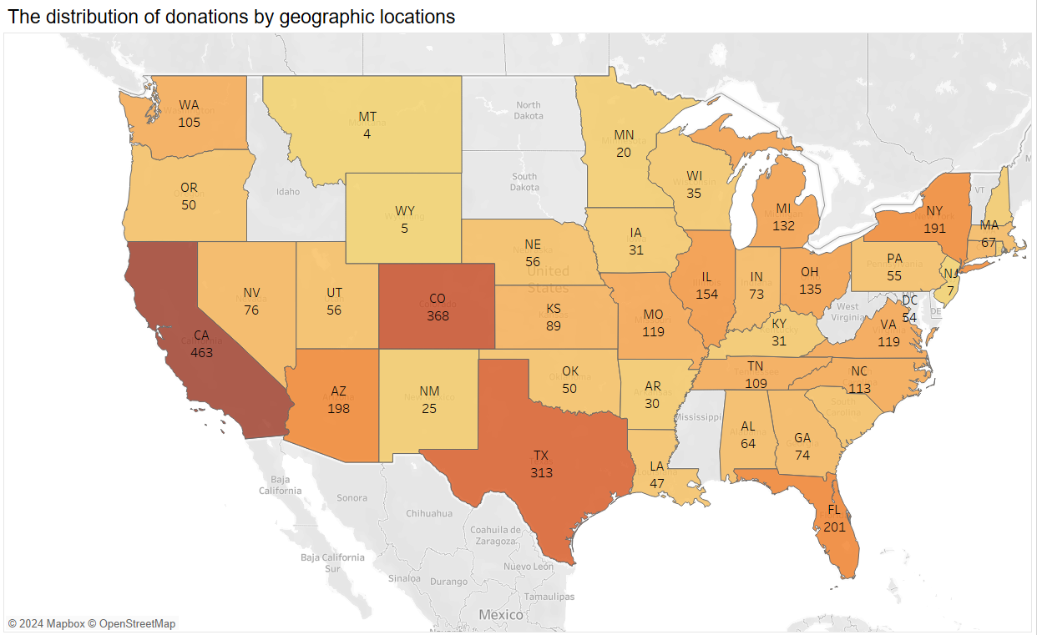

1.

Slide 5
2. The distribution of donations by the type of colleges
Top Recipients: College of Natural Science: $5,136,972 and College of Arts and Sciences: $4,720,313.
Moderate Recipients: College of Social Science ($3,694,437) and College of Agriculture and Natural Resources ($3,433,165) are mid-tier.
Lower Recipients: College of Nursing ($617,842), College of Communication Arts and Sciences ($577,251) and College of Veterinary Medicine ($242,598) receive comparatively lower donations.
Donation Preferences: Donors prioritize science-oriented colleges, potentially reflecting societal emphasis on STEM fields.
Improvement Areas: Colleges with lower funding, like Nursing or Communication, could benefit from focused fundraising campaigns or rebranding efforts to attract donors.

Slide 6
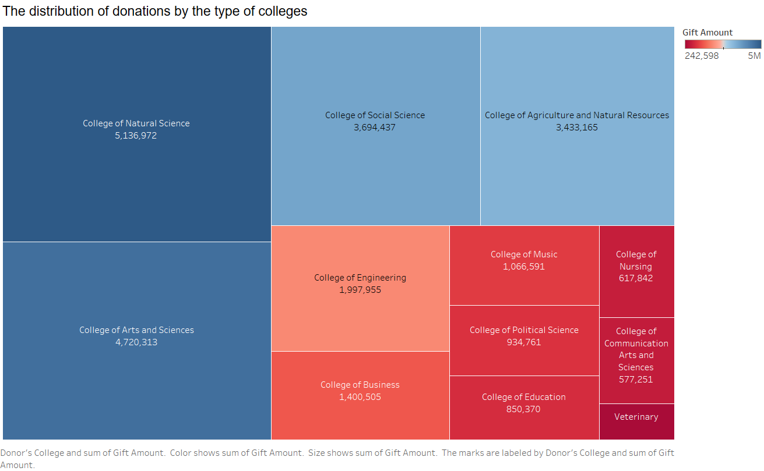
2.

Slide 7
3. The distribution of donations by academic majors
Top Donation: Engineering (No Major) has the highest donation. $562,519
Lowest Donation: Russian Major has the lowest donation. $69,337
Average Donation Range is around $263,603 to $168,134 within
Diverse Backgrounds: Donors come from a variety of academic fields, including business, engineering, and the sciences.
No Single Dominant Major: While some majors contribute more than others, there isn't a single major that significantly outweighs others.

Slide 8
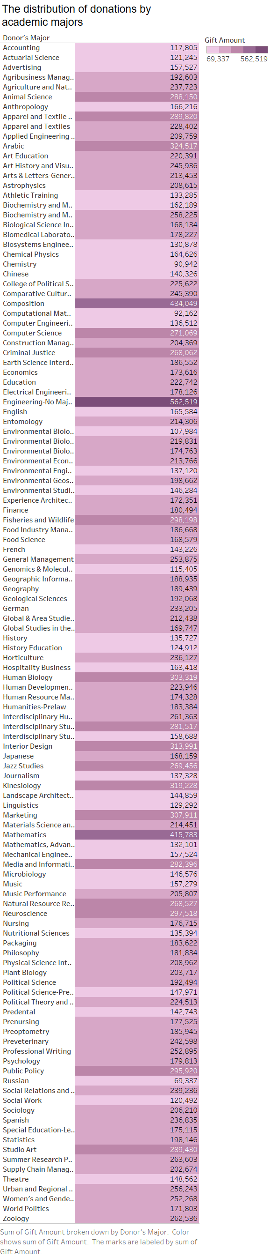
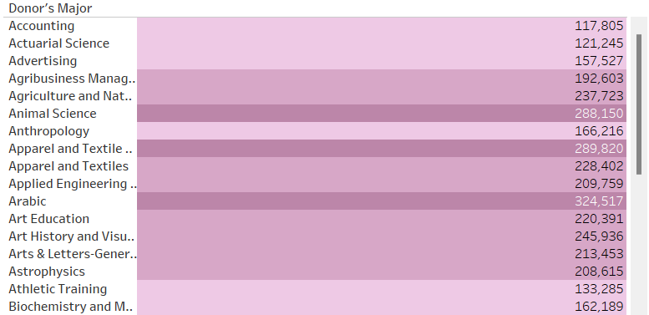
3.

Slide 9
4. The distribution of donations by graduation years
Q4 Spike: Many years show a noticeable spike in donations during Q4. This could indicate end-of-year giving patterns, such as holiday donations or fiscal-year-end contributions. Notably, the 2014 and 2015 graduation years show the highest donations in Q4, which may reflect successful donation drives or increased awareness.
Q1-Q3 Stability: In the first three quarters (Q1 to Q3), the donations fluctuate less, though there are dips in some years. For example, in 2012 and 2013, donations seem to dip in the earlier quarters before picking up again in the latter half of the year.
Year-to-Year Comparison: There appears to be a slight increase in donations for the graduation years between 2010 and 2015, with the donations for 2015 seeing a notable increase, especially in Q4.The 2012 cohort sees some irregularities, with donations dipping significantly in certain quarters compared to other years.
Recent Graduates: There appears to be a higher concentration of donations from recent graduates, suggesting a strong connection between alumni and the institution.

Slide 10
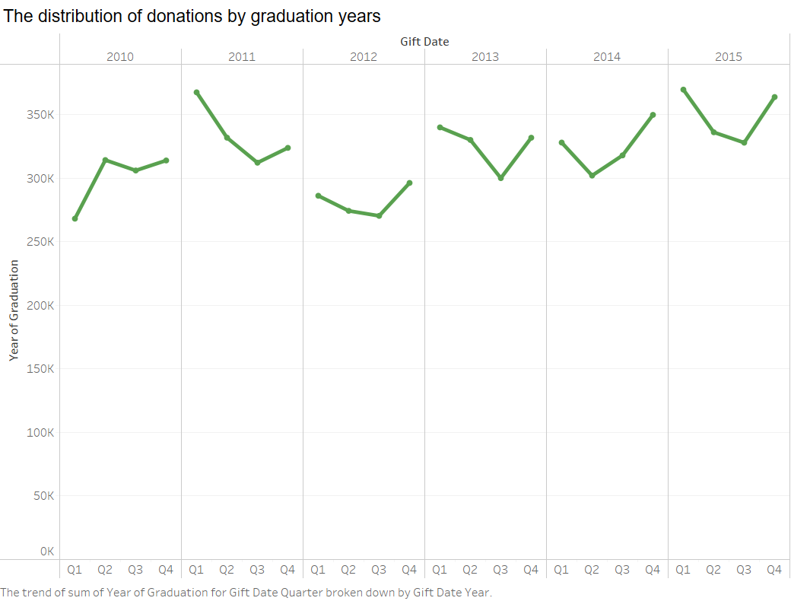
4.

Slide 11
5. Top majors of the donors
Diverse Backgrounds: Donors come from a variety of academic fields, including business, engineering, and the sciences.
Dominant Major: While some majors contribute more than others, there are a few majors that significantly outweighs others.
The Top 10 by Donor’s Major are Engineering No Major, Composition, Mathematics, Arabic, Interior Designing, marketing, Kinesiology, Human Biology, Neuroscience and Fisheries and Wildlife.
The rest are all Filtered out of the view but is shown in the Figures below.

Slide 12
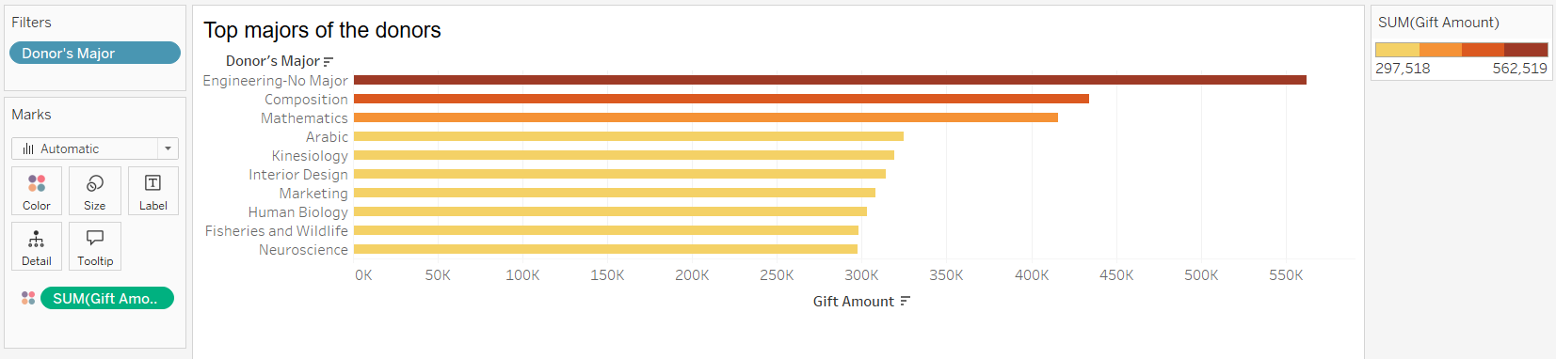
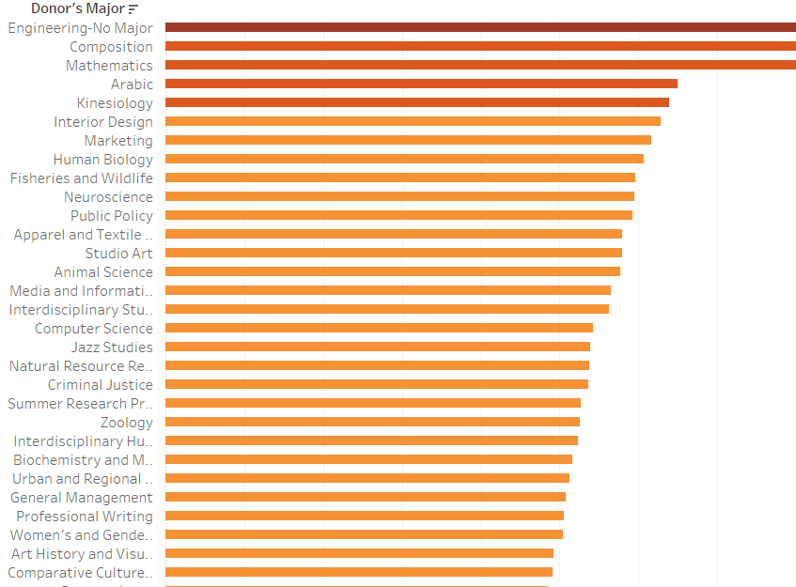
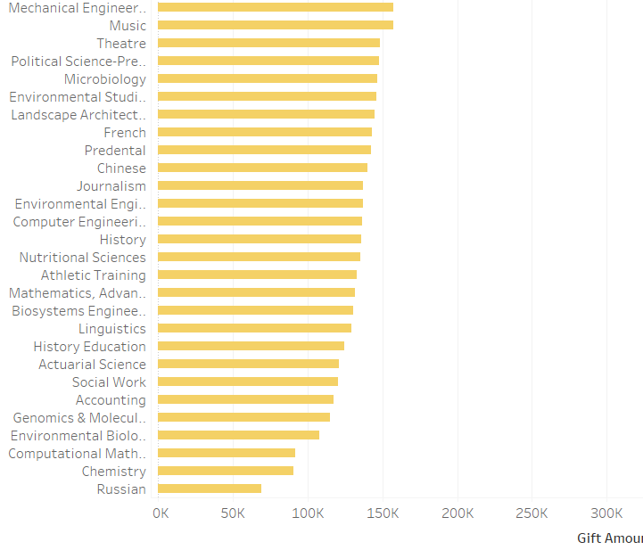
5.

Slide 13
6. Top types of colleges that received the most donations
College of Natural Science, College of Agriculture, College of Arts and College of Social Science: These college consistently ranks among the top recipients, suggesting a strong focus on on those education and research.
College of Engineering and College of Business seems to have a closer amount.
College of Vetinary Medicine and College of Communication Art and Science has the lowest amount of donations.
So there are only Four Top Colleges that have received the most Donations.

Slide 14
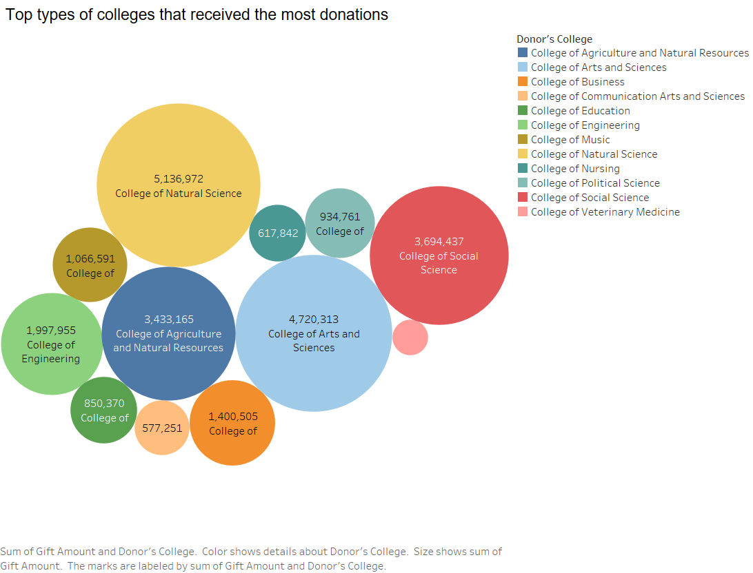
6.

Slide 15
7. The trend of donations over years
The overall trend is upward, indicating a growing interest in supporting these institutions.
There are slight fluctuations year-to-year, but the general direction is positive.
From the year 2010 to 2012 we can observe that the trend is a little apart as compared to the trend of the year range 2013 to 2015.
We can see that in the year 2013 there is a significant rise in the blue line trend i.e. the Donation Amount indicating that the donation amount had increased drastically and has crossed the blue line trend i.e. the Year of Graduation.

Slide 16
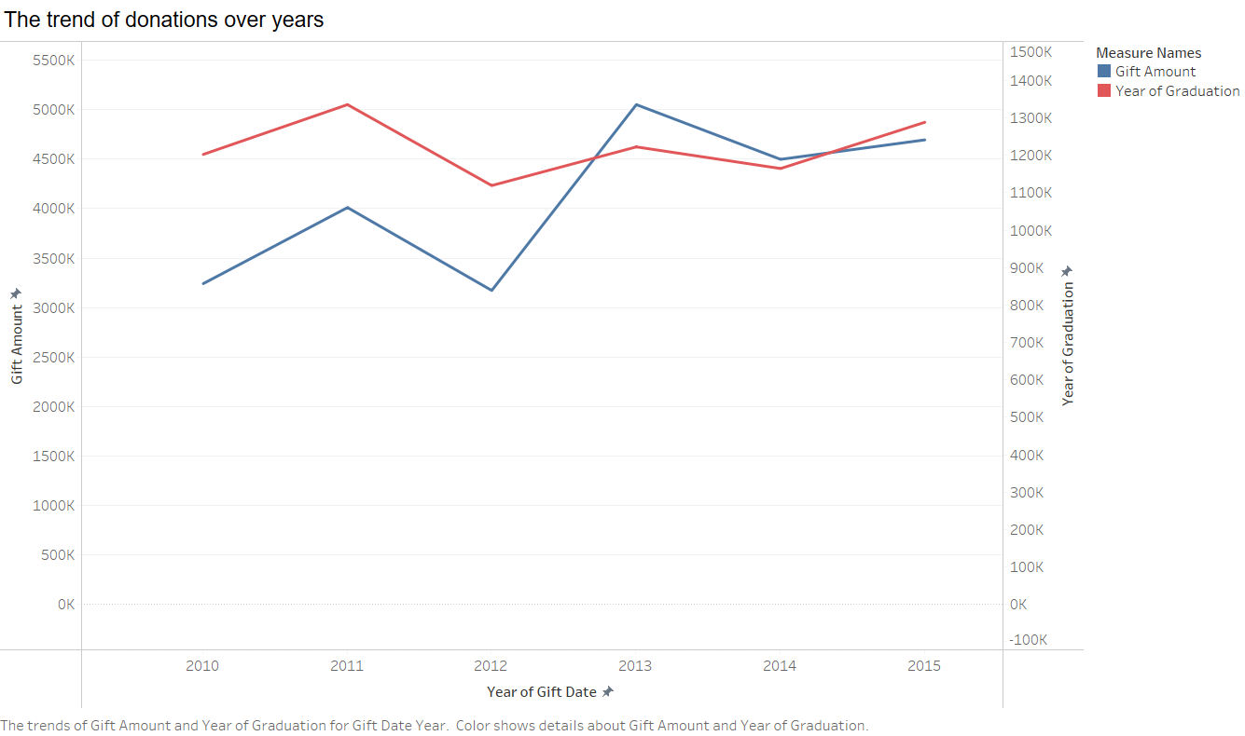
7.

Slide 17
Dashboard
Positive Trends:
Increasing Donations: The steady upward trend in donations over the years is encouraging and indicates growing support for the institution.
Geographic Reach: The distribution of donations across the United States demonstrates a national impact and reach.
Recommendations for Data Improvement:
Data-Driven Decision Making: Leverage data analytics to identify trends, opportunities, and areas for improvement in fundraising strategies.
Donor Engagement: Develop a strategic plan for donor engagement, including personalized communication, events, and volunteer opportunities.

Slide 18
